Slide 1

Social Media website
Rayan Adoum
Course: BEng (Hons) Software and Electronic Engineering

Slide 2
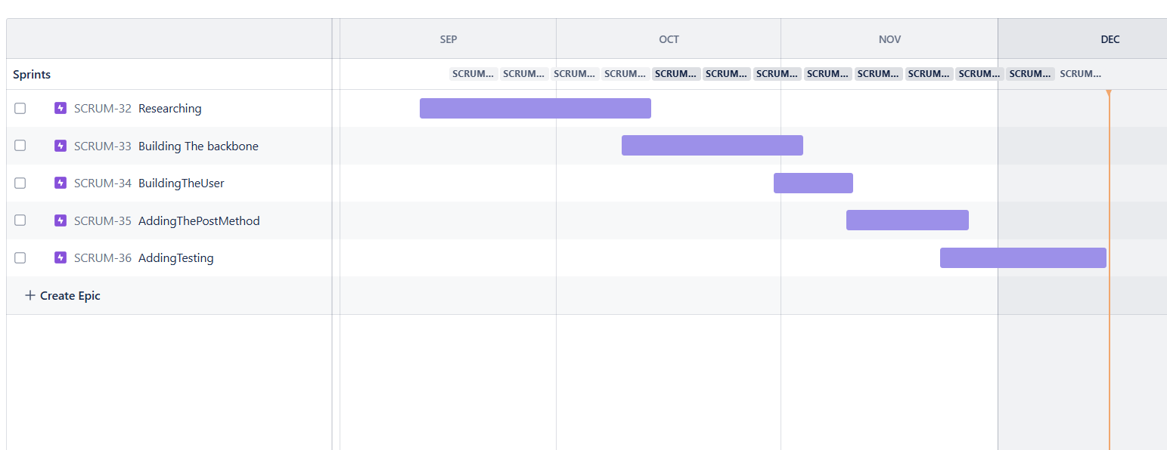
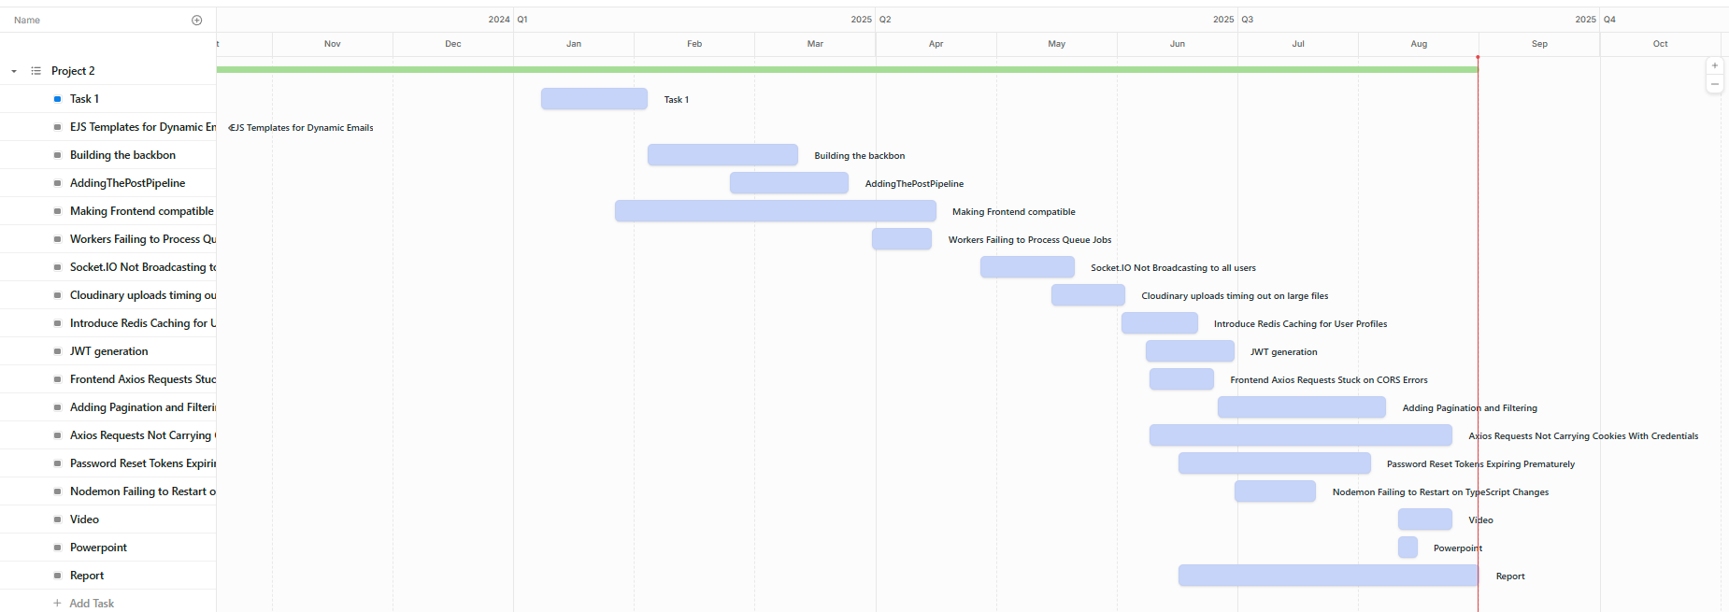

Project Management

Slide 3
Key technologies used
MongoDB
Express
React
Node.js
Redis
ISocket

Slide 4
Key Features
Realtime
Chat
Notifications
Caching
Queues
Authentication

Slide 5
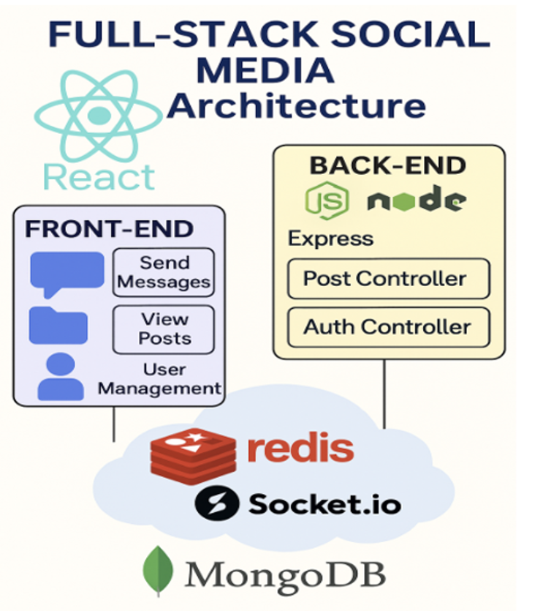

Slide 6
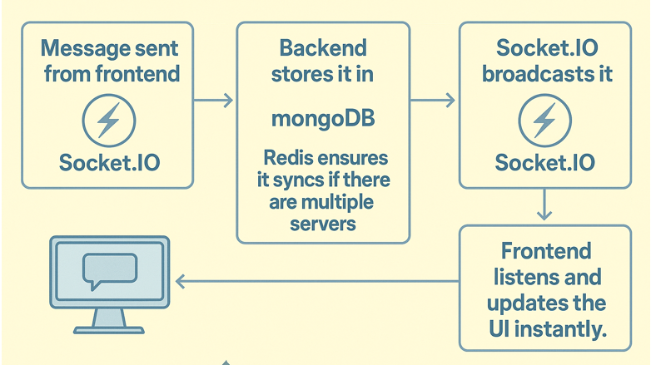

Slide 7
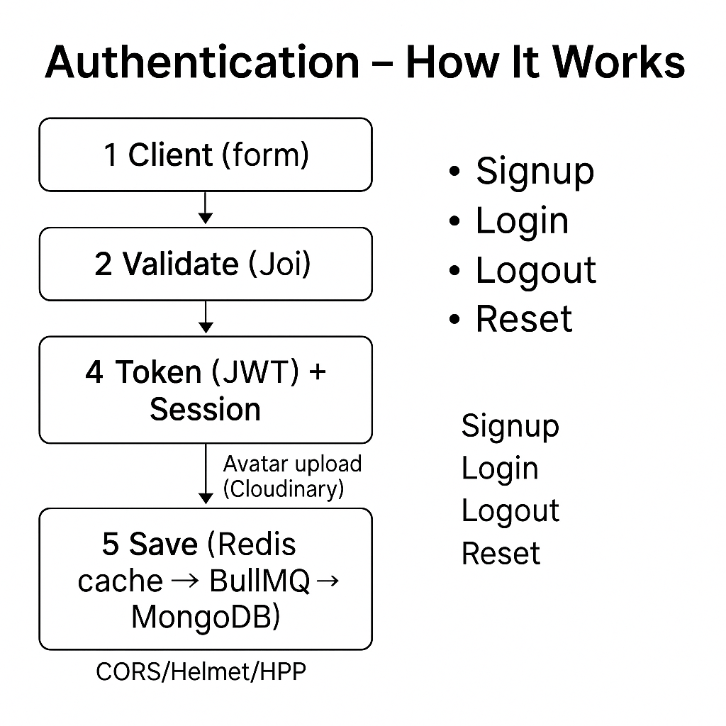

Slide 8
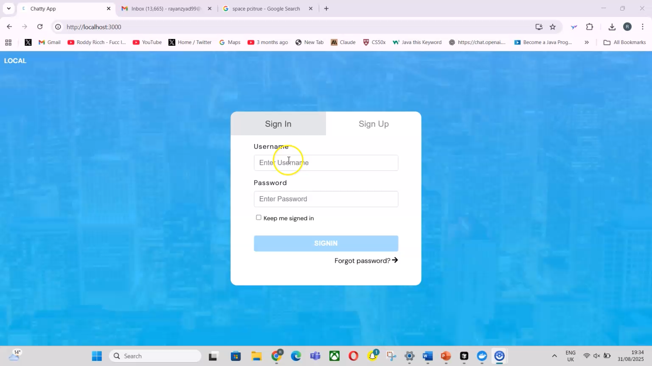
Demonstration

Slide 9

Thank you for listening

